Slide 1
Medicine, Ethics and the Holocaust: Reflecting on the Past to Protect the Future
Dr. stacy perlstein gallin
Founder and director
Maimonides institute for medicine, ethics and the Holocaust
www.mimeh.org

Slide 2
Medicine, Ethics and the Holocaust: Reflecting on the Past to Protect the Future
Program Description
This webinar will focus on the abrogation of biomedical ethics in World War II Germany, demonstrating how the Holocaust is a unique example of medically sanctioned genocide. The biomedical ethical considerations brought to light as a result of the alliance between medicine and the Nazis remain relevant for current medical and scientific practice, healthcare policy, and human rights endeavors. Eugenics, disability studies, end-of-life care, genetic testing, and human experimentation are all topics that are vital to the history as well as the future of bioethics. Exploring the pivotal role played by science and medicine in the labeling, persecution, and eventual mass murder of those deemed "unfit" is essential to preventing other instances of human rights abuses in modern society.
Target Audience
This continuing medical education offering is intended for physicians, pharmacists and nurses.
Learning Objectives
Upon completion of this knowledge activity, participants should be able to:
Explore the bioethical implications of the medical transgressions that took place during the Holocaust for modern scientific theory, medical practice, healthcare policy, and human rights endeavors.
Examine the unique confluence of events that took place in Germany in the early twentieth century that resulted in the merger of politics, science, and medicine in order to help better understand the rationale behind eugenics and Nazi racial hygiene policy.
Use the Holocaust as the historical framework to explore current human rights abuses in vulnerable populations and examine the ways in which minority cultures have been subjected to unethical medial practices under the guise of scientific progress.

Slide 3
Continuing Professional Education Credit is Available for this Program
Accreditation Statement
MedEDirect is accredited by the American Nurses Credentialing Center (ANCC), the Accreditation Council for Pharmacy Education (ACPE), and the Accreditation Council for Continuing Medical Education (ACCME), to provide continuing education for the healthcare team.
Credit Designation
MedEDirect designates this live educational activity for a maximum of 1.0 AMA PRA Category 1 Credits™ or 1.0 CPE credits (UAN # 0498-9999-16-002-L05-P).
Participants should claim credit commensurate with the extent of their participation in the activity. Participants must participate in the session and complete an activity evaluation before April 14, 2016. Pharmacists are required to pass the post-test with a minimum score of 70%.
Competencies
The following desirable physician attributes are addressed through this activity:
Provide patient-centered care
Work in interdisciplinary teams
Apply quality improvement
Claiming Credit
Activity Expires: 04/14/2016
To claim CME/CE credit, participants must complete the Program Evaluation and CME/CE Form in its entirety found at: http://www.mededirect.org/viewprogram.cfm?program=163

Slide 4
Medicine, Ethics and the Holocaust: Reflecting on the Past to Protect the Future
Dr. stacy perlstein gallin
Founder and director
Maimonides institute for medicine, ethics and the Holocaust
www.mimeh.org

Slide 5
Disclosures
This activity is not commercially supported. Support is provided by Maimonides Institute for Medicine, Ethics and the Holocaust.
Dr. Stacy Perlstein Gallin has nothing to disclose
MedEDirect
Thomas Zimmerman, PhD (Reviewer has nothing to disclose.
John Zitel (Content/Reviewer) has nothing to disclose
Danielle Amodio (Planner) has nothing to disclose.
A copy of MedEDirect’s policy on resolving conflicts of interest can be found at www.mededirect.org/faculty.

Slide 6
Introduction
Maimonides Institute for Medicine, Ethics and the Holocaust (www.mimeh.com)
Mission: explore the ethical implications of the medical transgressions that took place during the Holocaust for modern scientific theory, medical practice, healthcare policy, and human rights endeavors
Series of six webinars
Remember the Past; Protect the Future

Slide 7
The Holocaust: Medically Sanctioned Genocide
Social issues transformed into medical problems
People labeled as physically, mentally, or racially inferior based on scientific/medical “evidence”
Rise of eugenics- bettering society by improving human heredity; internationally accepted scientific theory
Science determines who is worthy of living and who should die
Medicine carries out death sentences

Slide 8
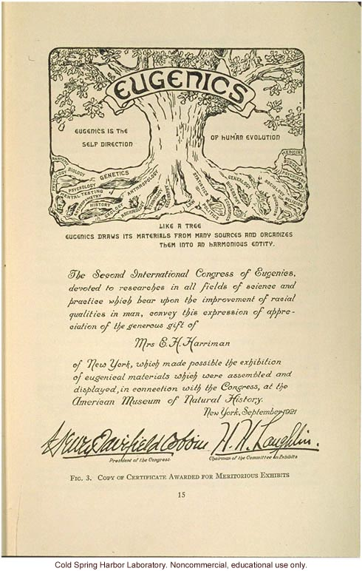
The Rise of Eugenics
Eugenics was introduced and rapidly popularized internationally as a method of social reform post WW I
Eugenics- “the science which deals with all influences that improve the inborn qualities of a race; also with those that develop them to the utmost advantage”
Bettering society by improving human heredity became an internationally accepted scientific theory
Francis Galton (1904). Eugenics: Its Definition, Scope, and Aims. American Journal of Sociology, 10 (1), p. 1.

Slide 9
Eugenics in Germany
Volk- Germany as a living, breathing organism with its own health and hygiene
Degeneration of Germany -> declining birthrate among the “better, more fit, and productive” class; increasing birthrate among the “physically and/or mentally unfit”
Individuals viewed as parts of a whole- productive members of society ONLY if they could benefit the Volk
Individual rights should be subverted in favor of what is in the best interest of society
Shift: Caring for individual -> Caring for society
Social problems became biological/medical problems

Slide 10
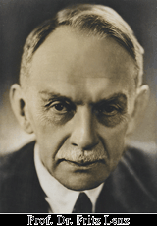
“the individual personality cannot be the final goal of ethics.[…]The people
(Volk) as an organism is the goal of our ethics[...].”
Florian Bruns. Turning Away From the Individual. Medicine and Morality Under the Nazis. In Nazi Ideology and Ethics, eds. Wolfgang Bialas and Lothar Fritze
Slide reproduced with the permission of Tessa Chelouche, M.D.
Prof. Dr. Fritz Lenz
Holder of the first Chair of Racial Hygiene in Germany

Slide 11
Politicization of Science and Medicine
National Socialism was more than a political movement- it was a way of life
Must promote a medical community that ministered to the strong instead of the weak
Willingness of physicians to offer medical care to sick and disabled allowed inferior elements to survive
Alfred Ploetz- “counterselective measures-” avoid medical care that would prolong the life of the unfit
National Socialism as “Applied Biology”- roots of behavior, positive and negative, attributed to genes
*Rudolf Hess, as cited in Robert Jay Lifton (2000). The Nazi Doctors: Medical Killing and the Psychology of Genocide, p. 129.

Slide 12
Eugenics: From Theory to Practice
Political ideals of Nazi Party- systemically identify, socially isolate, and legally persecute the unfit
Scientific/Medical ideal- use genetics to better society
Nazi Vision: use science and medicine to gain total control of the biological process of evolution
Goal: ensure the health and strength of the German nation
Incorporating eugenics and race hygiene into National Socialism provided necessary scientific justification
Laws and policies portrayed as public health measures intended to protect and improve the Volk

Slide 13
Medicine in Nazi Rhetoric
Unifying principle of Nazi Party was a deadly racial disease; solution was to rid Germany of that disease by any means necessary
Medicalization of society- medical cure for society’s ailments
Hitler as “Great Doctor of the German people”
“Of course I am a doctor and I want to preserve life. And out of respect for human life, I would remove a gangrenous appendix from a diseased body. The Jew is a gangrenous appendix in the body of mankind.” Fritz Klein
Robert Jay Lifton, (2000). The Nazi Doctors: Medical Killing and the Psychology of Genocide, p. 29.

Slide 14
"You, you National Socialist doctors, I cannot do without you for a single day, not a single hour. If not for you, if you fail me, then all is lost.”
Adolf Hitler
Robert Proctor (1988). Racial Hygiene: Medicine Under the Nazis, p. 64. Reproduced with permission from Tessa Chelouche, M.D.

Slide 15
Physicians During the Holocaust
Provided scientific justification for public policy measures
Enforced public policies through hereditary health courts
Decided which children would live or die based on nothing but a questionnaire
Injected lethal doses of medication into handicapped children and adults
Falsified death certificates
Selected who would be sent to an immediate death and who would be forced into labor on the ramps at concentration camps
Performed torturous “medical experiments” on concentration camp prisoners in the name of scientific progress
Operated the gas chambers that killed millions of innocent victims

Slide 16
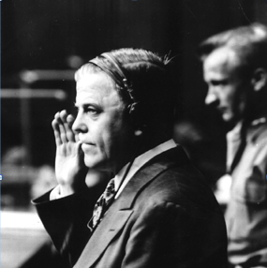
“Had the profession taken a strong stand against the mass killing of sick Germans before the war, it is conceivable that the entire idea and technique of death factories for genocide would not have materialized.” Dr. Andrew C. Ivy, M.D
Andrew C. Ivy M.D. AMA Medical Scientific Consultant at the Doctors’ Trial, Nuremberg 1946. In Alexander Mitscherlich, Fred Mielke. Doctors of Infamy. The Story of the Nazi Medical Crimes. 1949. Reproduced with permission from Tessa Chelouche, M.D.

Slide 17
Just Because We Can, Does That Mean We Should?
“They too asked and answered the question, ‘Who shall live and who shall die? And who belongs to the community entitled to our protection?’ Then and now, the subject at hand is killing and letting die, and helping to die, and using the dead. Then and now, the goal is to produce healthier human beings and, perhaps, a better quality of human being.”
Richard John Neuhaus, (1992). The Way They Were, The Way We Are. In When Medicine Went Mad: Bioethics and the Holocaust, ed. Arthur L. Caplan, p. 216.

Slide 18
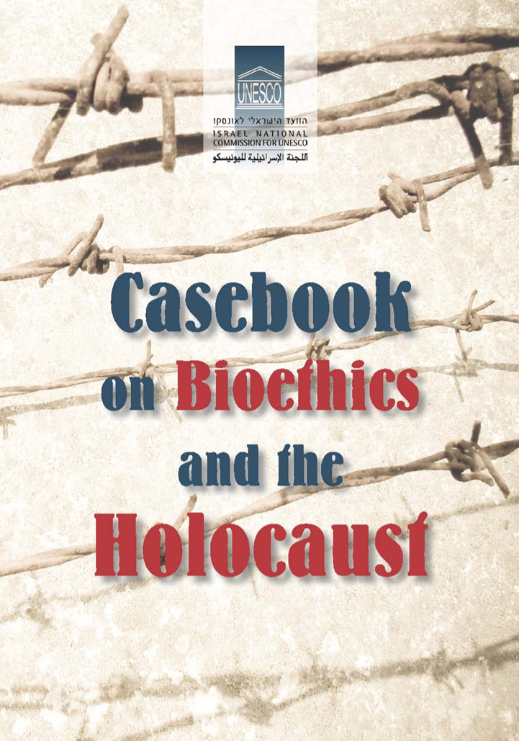
Implications for Current Medical Ethics
*Beginning of Life Issues
*End of Life Issues
*Human Subject Research
*Human Rights Efforts
Healthcare providers must be grounded in a moral ethos that values the respect for human life above the promise of medical advancement and societal progress!

Slide 19
Principles of American Bioethics
Tom Beauchamp and James Childress, 1983
Autonomy/Respect for persons – recognize people as autonomous agents and requires that their choices be observed
Beneficence- maximize benefit for subject
Nonmaleficence- do no harm, minimize risk
Justice- treat all potential subjects equally

Slide 20
Human Genome Project
Human Genome Project – map and sequence estimated 3 billion base pairs of the human genome for the purpose of gene identification, separation, and splicing
Intention: discover cause of disease, determine treatment and cure
Possible outcome: choosing the qualities society deems favorable for future generations

Slide 21
Genetic Testing and Manipulation
What is the proper use of genetic testing?
Who determines what is a “proper” or “improper” use of this technology
Subjective value judgment
How will the data we obtain from genetic testing be used? How “should” it be used?
Personal or societal choice?
Should there be governmental regulations to ensure the proper use of this “medical advancement?”

Slide 22
Assisted Reproductive Technology (ART)
“All fertility treatments in which both eggs and sperm are handled” Centers for Disease Control & Prevention
“In general, ART procedures involve surgically removing eggs from a woman’s ovaries, combining them with sperm in the laboratory, and returning them to the woman’s body or donating them to another woman”
In Vitro Fertilization- fertilization outside of the body- most common ART method
IVF- treatment for infertility or genetic problems - Mayo Clinic
http://www.cdc.gov/art/whatis.html

Slide 23
Preimplantation Genetic Diagnosis (PGD)
Screening test used to determine if genetic or chromosomal disorders are present in embryos produced through in vitro fertilization (IVF). PGD screens embryos before they are transferred to the uterus so couples can make informed decisions about their next steps in the IVF process. Embryos unaffected by the genetic or chromosomal disorder can be selected for transfer to the uterus.
Recommended when:
**One or both partners has a history of heritable genetic disorders or is a carrier of a chromosomal abnormality
**The mother is of advanced maternal age or has a history of recurrent miscarriages
http://www.pennmedicine.org/fertility/patient/clinical-services/pgd-preimplantation-genetic-diagnosis/

Slide 24
Stem Cell Research
Stem cell research- remove cells from human embryos for the purpose of medical testing; embryos are destroyed in the process
Cells often come from embryos left over from IVF
Goal: determine treatment, cure for diseases
March 9, 2009: President Obama reversed 2001 Executive Order limiting federal funding for stem cell research; promised to “make scientific decision based on facts, not ideology.”
http://www.researchamerica.org/advocacy-action/issues-researchamerica-advocates/stem-cell-research/timeline-major-events-stem-cell

Slide 25
In Nazi Germany abortions were illegal for all healthy Aryan women, but were enforced for eugenic reasons on other women.
Abortion
Robert Proctor (1988). Racial Hygiene: Medicine Under the Nazis. Reproduced with permission from Tessa Chelouche, M.D.
“ A pregnancy must not be terminated”

Slide 26
Abortion: Individual or Societal Decision?
Is this a personal decision where an individual’s right to choose should be protected?
Is this a societal decision about personhood that warrants legislation to protect human rights of vulnerable populations?
Politicization of medicine
“With respect to human dignity and human rights, the reality is what we define it to be. Rights are created by our assignment of rights.”
Richard John Neuhaus, (1992). The Way They Were, The Way We Are. In When Medicine Went Mad: Bioethics and the Holocaust, ed. Arthur L. Caplan, pp. 227-228.

Slide 27
Ethical Concerns
German eugenics - sterilization to improve quality of future generations morphed into “medicalized killing” to improve the quality of current generation
By enacting legal policies, government is making legal decisions about ethical issues
Is this merger of science and politics setting a dangerous precedent?
Warring bioethical principles

Slide 28
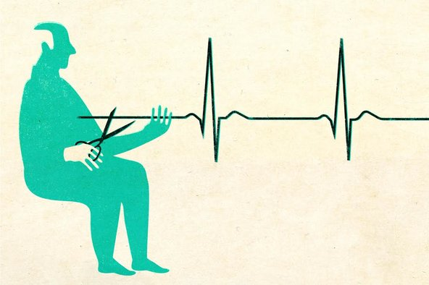
End of Life Care
Active Euthanasia – taking deliberate action to end a patient’s life
Passive Euthanasia – withdrawing medical care with the deliberate intention of ending a patient’s life
Assisted Suicide – providing the means for a patient to end his or her own life

Slide 29
Physician Assisted Suicide in the US http://www.newsweek.com/physician-assisted-suicide-always-wrong-317042
Doctors can PRESCRIBE lethal medications for mentally competent, terminally ill patients 18 and over; CANNOT administer medication (active vs. passive)
Legal in five states: OR, VT, WA, MT, NM
Fear that participation in death of a patient could lead to indifference about value of human life
http://www.cnn.com/2014/11/26/us/physician-assisted-suicide-fast-facts/

Slide 30
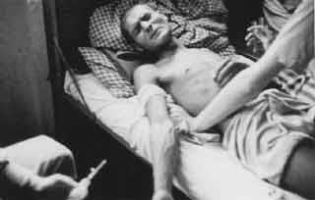
Medical Experimentation in WW II
*Doctors performed 26
different types of medical
experimentation
*Goal: obtain info that could
be used to further advance
science, medicine, the military
and society
*Unique opportunity to access
human subjects for “research
purposes” without any legal or
ethical boundaries Photo obtained from United States Holocaust Memorial Museum website
Dehumanization and medicalization allowed physicians to abandon Hippocratic obligations

Slide 31
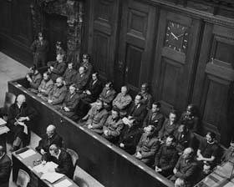
The defendants’ dock and members of the defense council during the Doctors’ Trial. Nuremberg, Germany Dec. 9, 1946 – Aug. 20, 1947
“The defendants in this case are charged with murders, tortures, and other atrocities committed in the name of medical science. victims of these crimes numbering the hundreds of thousands.”
Chief Prosecutor, Brig. General Telford Taylor
-United States Holocaust Memorial Museum

Slide 32
The Nuremberg Code
Nuremberg Code- ten characteristics of acceptable research involving humans
“The voluntary consent of the human subject is absolutely essential.”
Places autonomy (in the form of mandatory informed consent) above all other principles
Problematic due to the perceived necessity of research including those who cannot give voluntary, informed consent (children, psychiatric, emergency)- vulnerable populations
Notes:
Informed consent is an ideal- doesn’t always work in practice

Slide 33
Nuremberg Declaration GMA 115th Assembly 2012
“The crimes were not simply the acts of individual doctors, but rather took place with the substantial involvement of leading representatives of the medical association and medical specialist bodies, as well as with the considerable participation of eminent representatives of university medicine and renowned biomedical research facilities. These human rights violations, perpetrated in the name of medicine under the Nazi regime, continue to have repurcussions to this day and raise questions concerning the way in which physicians perceive themselves, their professional behavior, and medical ethics.”
Supplement to: Kolb S, Weindling P, Roelcke V, Seithe H. Apologising for Nazi medicine: a constructive starting point. Lancet 2012; 380: 722–23. Reproduced with permission from Tessa Chelouche, M.D.

Slide 34
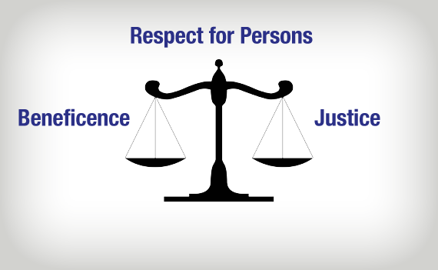
Human Rights Abuses in Vulnerable Populations
Tuskegee Syphillis Experiment (1932 – 1972)
Jewish Chronic Disease Hospital (1963)
Willowbrook Study (1955 – 1970)
“The Immortal Life of Henrietta Lacks”
HIV trials in developing countries (1980’s & 1990’s)
Physician participation in “enhanced interrogation techniques” and the death penalty (2000’s – present)

Slide 35
What Have We Learned?
Science and ethics are not objective, distinct entities - exist in the context of political, societal, cultural, religious and economic settings
Healthcare profession is not immune to abuse of power
Physicians abandoned responsibility to individual patient in favor of duty to societal advancement
There are differences between “then” and “now,” and we must be cautious in our use of the Nazi analogy
It is our responsibility to remain vigilant in order to ensure that the horrors of the Holocaust are never repeated

Slide 36
How can we ensure a balance between scientific advancement and human dignity?
New Challenges in Medicine
*Third party payers guiding the limits of medical practice
*Rapid advancement of medical technology -> longer lives, but at what cost?
*Issues of equity, justice, access to care, and the treatment of vulnerable populations
*Developments in beginning and end of life care are changing the face of medicine, law, and politics

Slide 37
Call to Action
Need to study the participation of the medical community in the abrogation of ethics that took place in WWII
Importance of clearly delineating roles, responsibilities and moral obligations of physicians and guiding principles of medical practice
“Every medical student should become fully
cognizant of the disastrous consequences that
stemmed from the failure of German doctors
to adhere to the fundamental admonition of
their calling: primum non nocere—
first do no harm.”
*Jordan J. Cohen, (2010). Medical Professionalism: Lessons from the Holocaust. In Medicine After the Holocaust: From the Human Genome to the Master Race and Beyond, ed. Sheldon Rubenfeld, p. 207.

Slide 38
Maimonides Institute for Medicine, Ethics and the Holocaust
Thank you for participating in our webinar!
In order to preserve the memory of those who lost their lives during the holocaust, our educational programming is offered free of charge. If you enjoyed this program and would like to support mimeh’s mission, please consider donating today at
WWW.MIMEH.org
Next Webinar: april 18, 2016- 12:00 pm est
human genetics: from eugenics to the human genome project and beyond- tessa chelouche, m.d.

